Slide 1


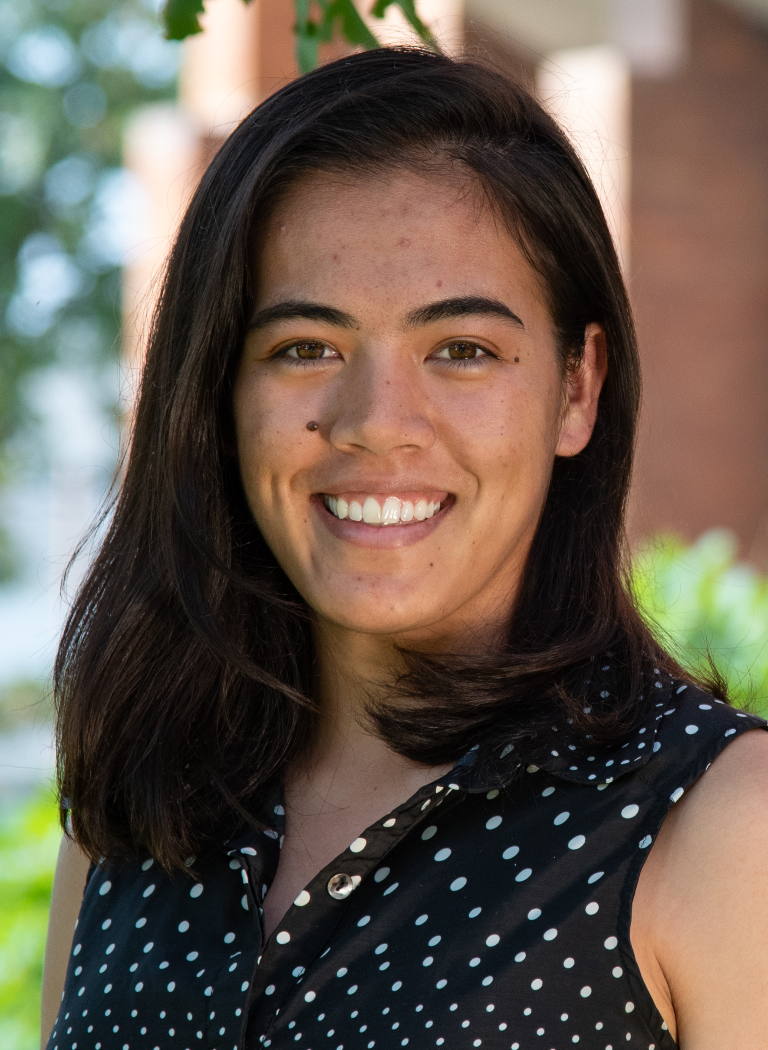

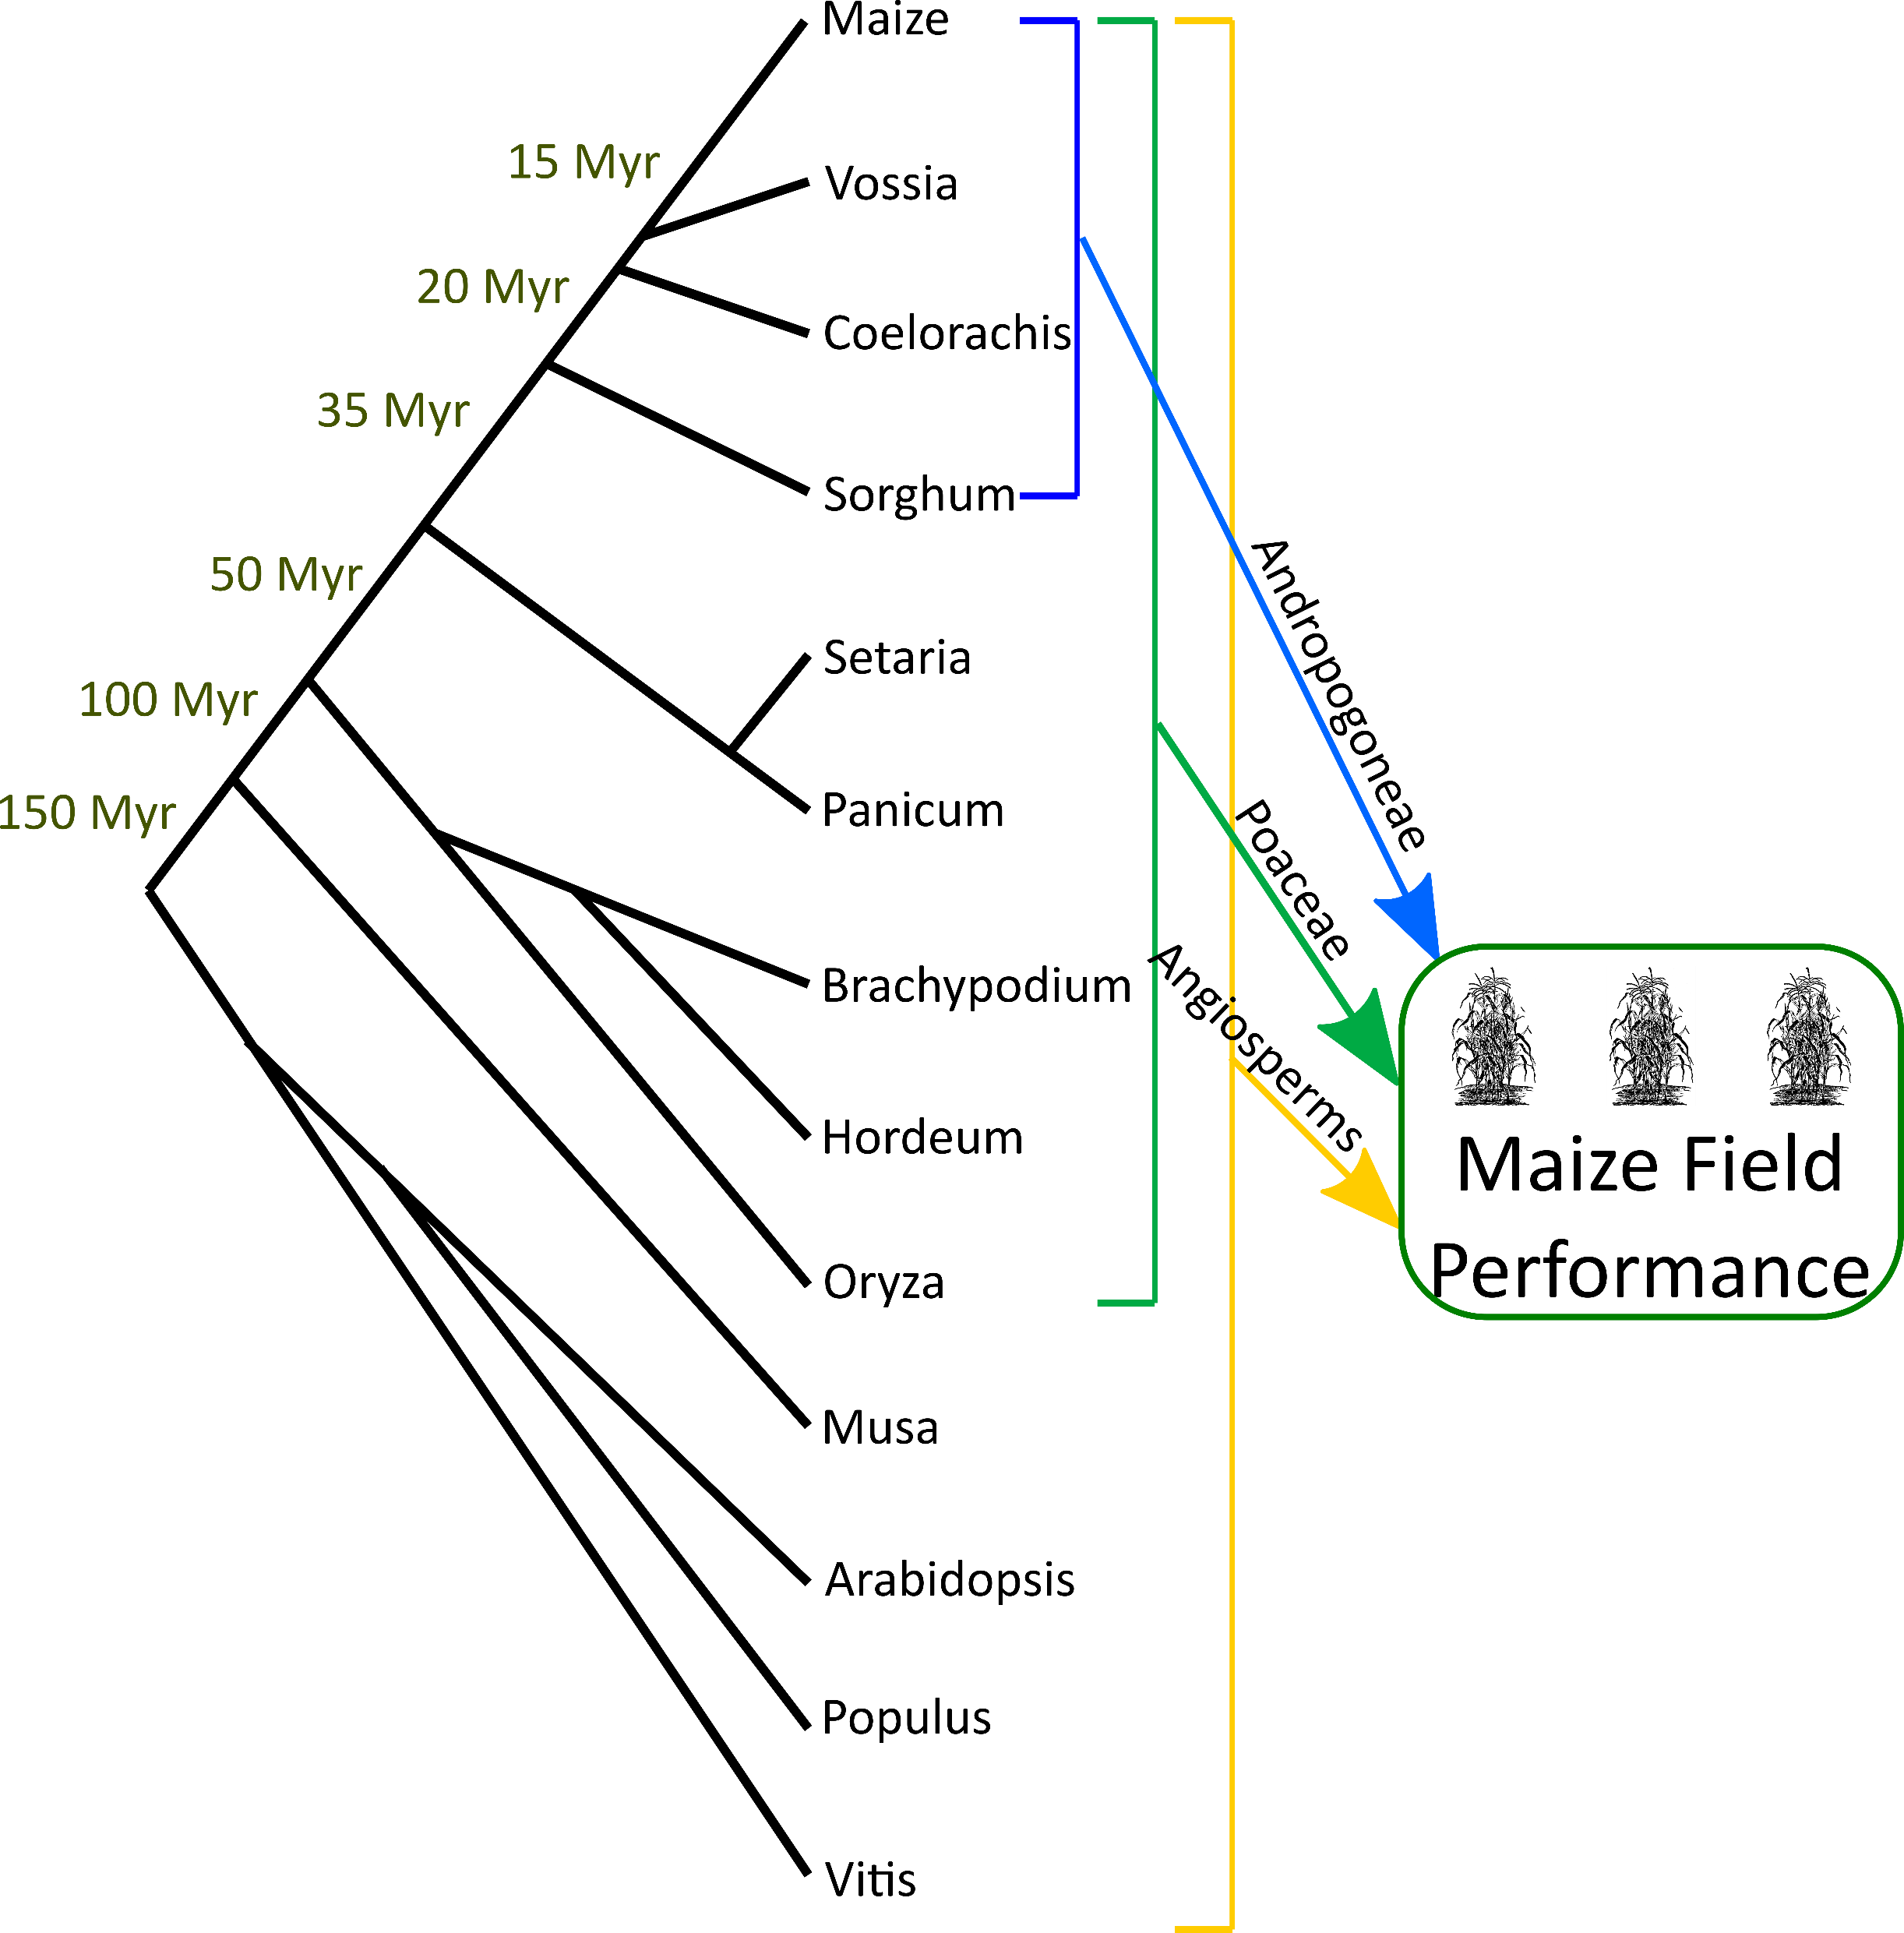
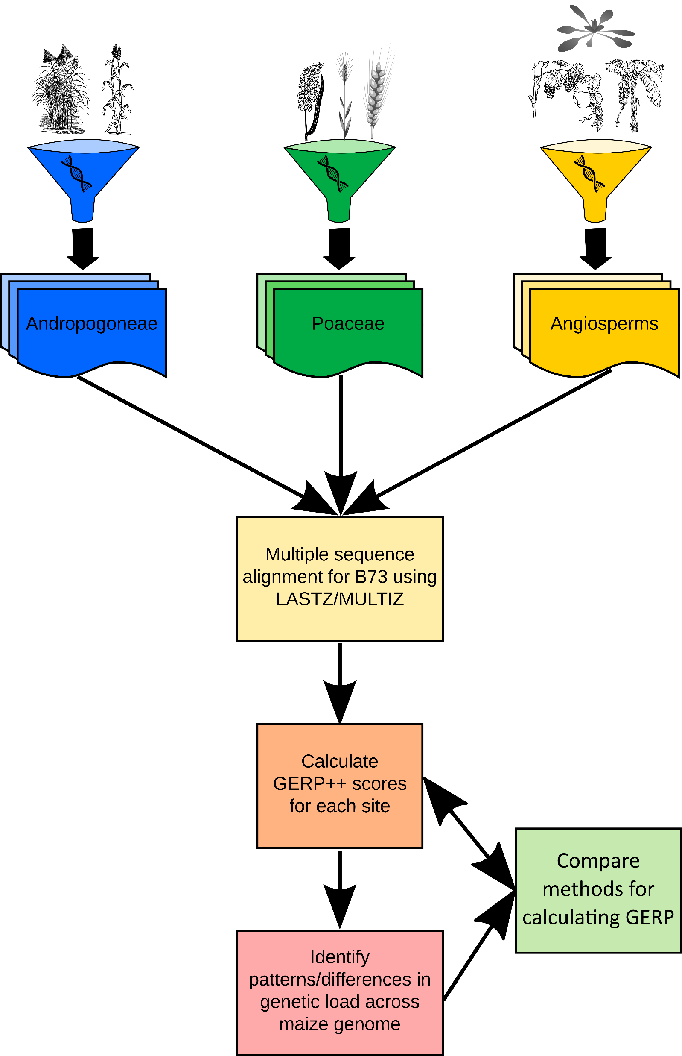
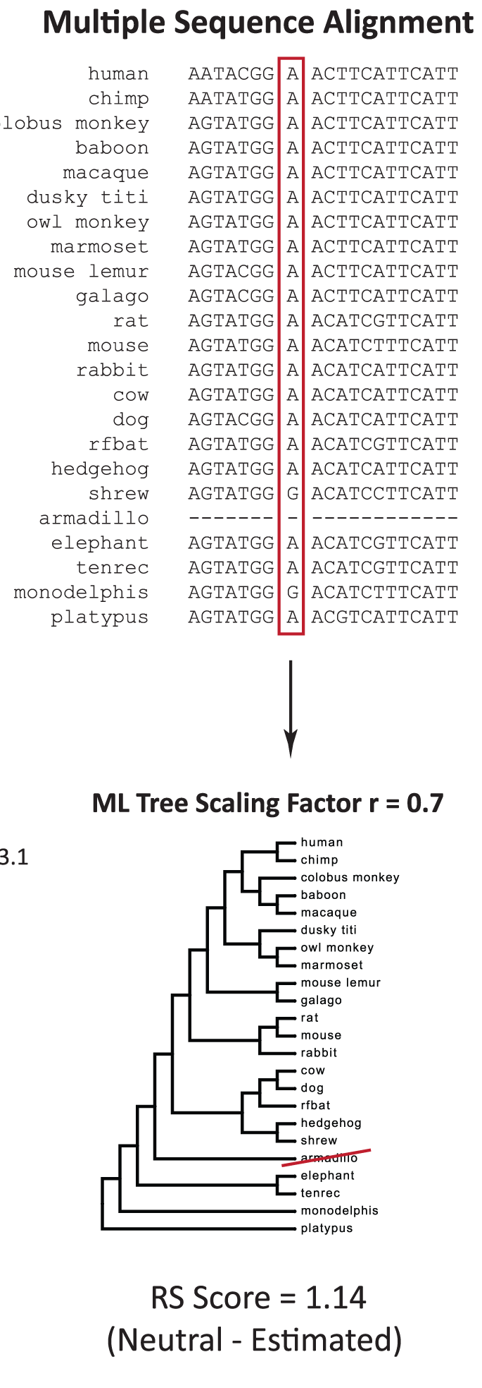
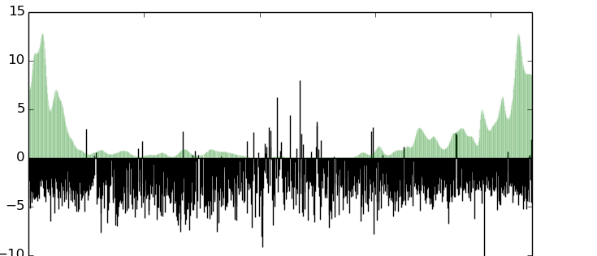
Estimation of conservation using divergence between maize and sorghum with the Andropogoneae tribe
Merritt B. Burch (mbb262@cornell.edu)¹, Baoxing Song², Cinta M. Romay², Elizabeth Kellogg³, Edward S. Buckler^{1,2,4}
1 Section of Plant Breeding and Genetics, Cornell University, Ithaca, NY 14853, 2 Institute for Genomic Diversity, Cornell University, Ithaca, NY USA 14853, 3 Donald Danforth Plant Science Center, St. Louis, MO USA 63132, 4 USDA-ARS; Ithaca, NY, USA 14853
Why use the Andropogoneae to find conservation?
Finding evolutionary conserved regions is limited by experimental manipulation or existing variation between species
The Andropogoneae tribe:
1,200 species
NADP-ME C₄ photosynthesis
Common ancestor 16-20 Mya
Sequencing ~900 Andropogoneae = >1 billion years of independent evolution
Different evolutionary time depths predict mutation effects
Goals
Compare across Andropogoneae, Poaceae, and Angiosperm genomes:
How deleterious is any single mutation?
Do different evolutionary time depths provide equivalent estimates of deleterious or fitness mutation effects?
Calculating Genomic Rate Profiling (GERP) scores
Uses sequence alignment to quantify constrained regions
GERP in Humans
Next Steps
Compare and contrast the power and sensitivity of GERP constraint by clade in:
Functional elements of genes
Protein families & domains
Intergenic regulatory regions
Future Directions
Use GERP estimates to design heterosis and find loci for gene editing
Create machine learning models that predict transposable element families and hijacking into functional elements
Examine patterns within ~1 billion years of independent transposable element activity
Purifying selection not completely working in maize
Proportion of deleterious mutations is high under low allele frequencies
Proportion of SNPs
Derived Allele Frequency
(Fei Lu, Unpublished)
Deleterious mutations are everywhere! Enriched in low recombination regions.
References
Davydov, E. V., et al., (2010). Identifying a high fraction of the human genome to be under selective constraint using GERP++. PLoS Computational Biology, 6(12), e1001025.
Rodgers-Melnick, E., Bradbury, P. J., et al., (2015). Recombination in diverse maize is stable, predictable, and associated with genetic load. Proceedings of the National Academy of Sciences of the United States of America, 112(12), 3823–3828.
GERP Score
Recombination Rate
(Davydov et al., 2010)
-10
Chromosome 5 Position
(Rodgers-Melnick et al., 2015)
Funding Acknowledgements: National Science Foundation, Plant Genome Research Project IOS#1822330; United States Department of Agriculture – Agricultural Research Service; Cornell University, Cornell Recruitment Fellowship

